Slide 1
.NET (Core) Introduction
Miroslav Popović
Technical Lead, Seavus Group
@miroslavpopovic
https://miroslavpopovic.com
Notes:
So what is .NET?

Slide 2
History

Slide 3
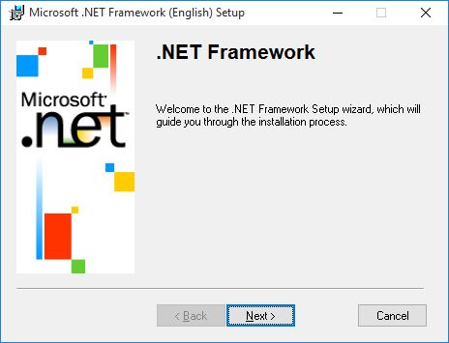
.NET History
.NET Framework 1.0, VS.NET
.NET Framework 1.1, VS.NET 2003
.NET Framework 2.0, VS 2005
.NET Framework 3.0, WPF, WCF, WF
.NET Framework 3.5, VS 2008, LINQ
.NET Framework 4.x…, VS 2010+
ASP.NET MVC, Web API…
.NET Core

Slide 4
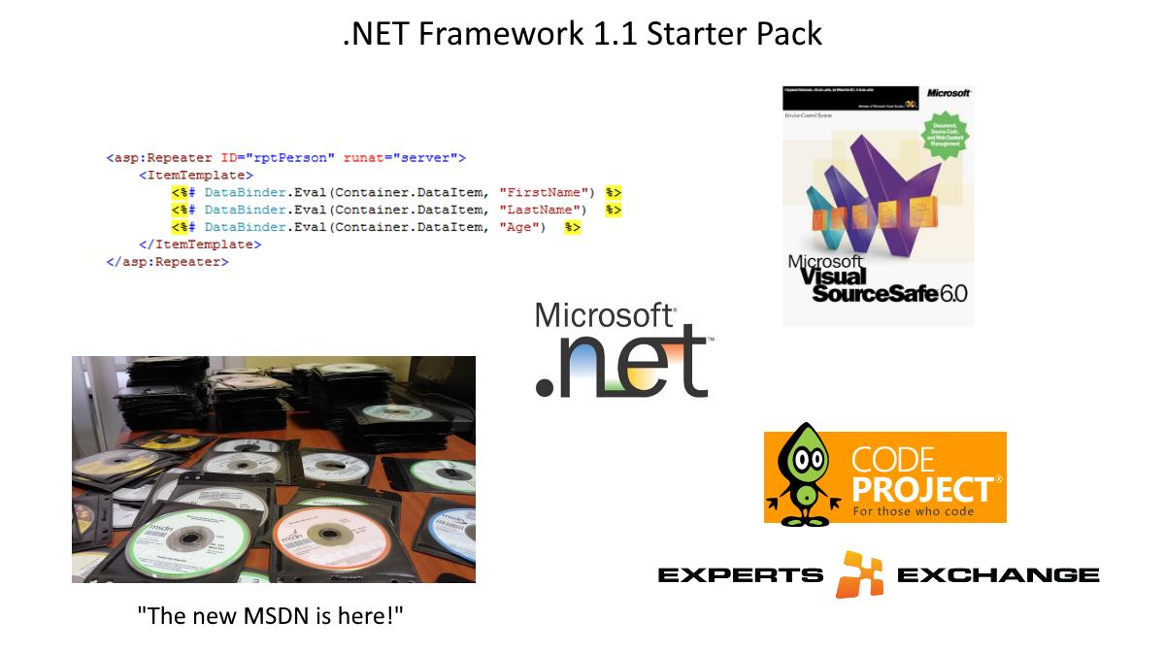
Blast from the past

Slide 5
.NET
Free. Cross-platform. Open source.
A developer platform for building all your apps.
www.dot.net

Slide 6














Your platform for building anything
DESKTOP
WEB
CLOUD
MOBILE
GAMING
IoT
AI
.NET
Notes:
You can build anything with .NET. From desktop apps to cloud-native services, iPhone and Android mobile apps to artificial intelligence, you can build almost anything with the .NET platform.

Slide 7










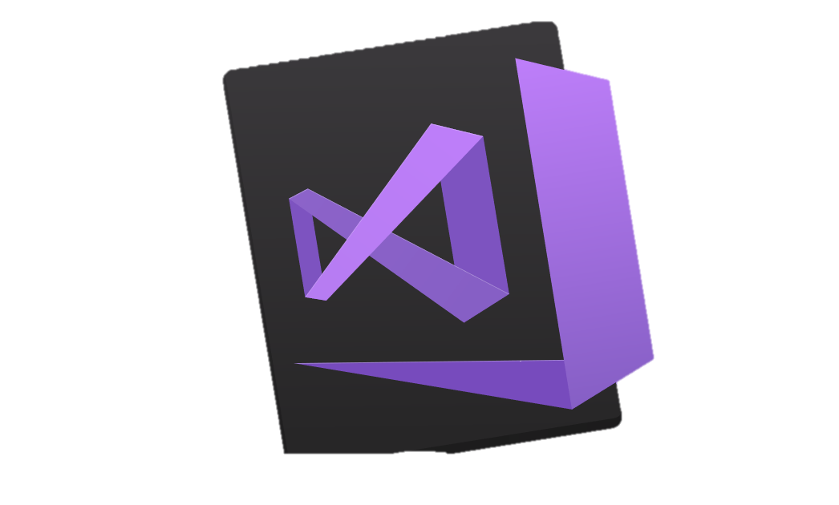



.NET is a software development platform
TOOLS
DESKTOP
WEB
CLOUD
MOBILE
GAMING
IoT
AI
VISUAL STUDIO
.NET STANDARD
VISUAL STUDIO FOR MAC
LIBRARIES
VISUAL STUDIO CODE
INFRASTRUCTURE
RUNTIME COMPONENTS
COMPILERS
LANGUAGES
COMMAND LINE INTERFACE
Notes:
.NET is an entire software development platform that takes care of a lot of the heavy lifting for you when you want to build an application. Applications frameworks help you build the specific types of apps or workloads and enable you to literally build any app for any platform with any operating system. Each .NET workload shares a common infrastructure and .NET Standard library. This means not only are your .NET skills portable, but your actual code is portable no matter what you’re building. This makes it easy to share reusable components (called libraries) across the breadth of applications people build.
Additionally, there are a broad set of development tools that makes it really productive to write, debug, build and manage code bases.
See: www.dot.net

Slide 8
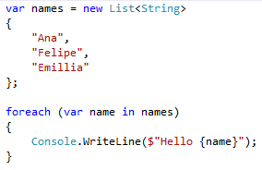
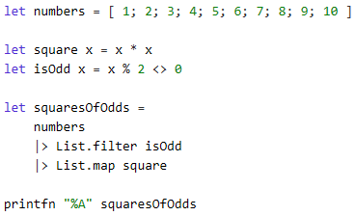
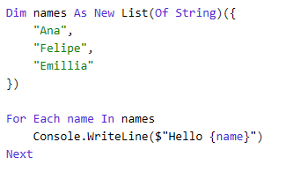
You can write code with many .NET languages
C# (c-sharp)
C# is a simple, modern, object-oriented, and type-safe programming language
Its roots in the C family of languages makes C# immediately familiar to C, C++, Java, and JavaScript programmers
F# (f-sharp)
F# is a cross-platform, open-source, functional programming language for .NET
It also includes object-oriented and imperative programming
Visual Basic
Visual Basic is an approachable language with a simple syntax for building type-safe, object-oriented apps
Notes:
(Speak to slide bullet points.)

Slide 9
Growth
>1 million .NET Core developers
Visual Studio, Visual Studio for Mac, Visual Studio Code
Visual Studio
+1 million new monthly active .NET developers in last year

Slide 10
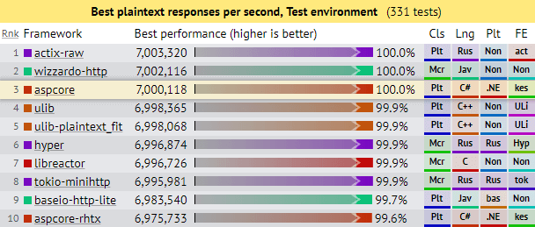
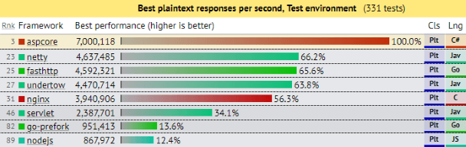
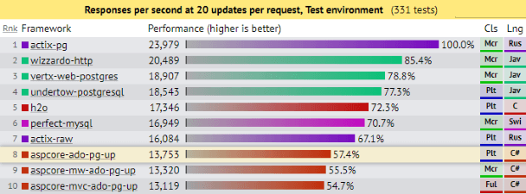
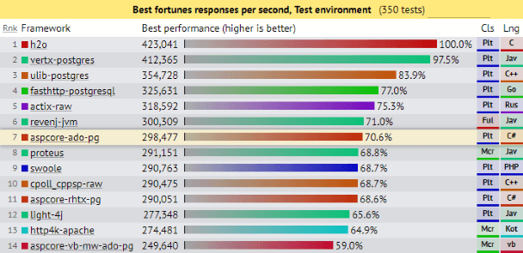
.NET is Fast. Really Fast!
Notes:
.NET is fast. Really fast! That means applications provide better response times and require less compute power. StackOverflow serves 5.3M page views a day on just 9 servers!
The popular TechEmpower benchmark compares web application frameworks with tasks like JSON serialization, database access, and server side template rendering - .NET performs faster than any other popular framework.
https://www.techempower.com/benchmarks/
The community has played a crucial role in performance work for the .NET stack.
https://blogs.msdn.microsoft.com/dotnet/tag/performance/
https://www.ageofascent.com/2019/02/04/asp-net-core-saturating-10gbe-at-7-million-requests-per-second/

Slide 11
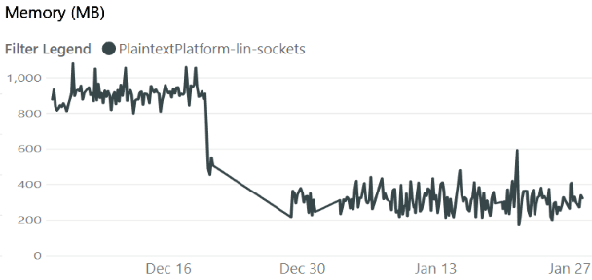
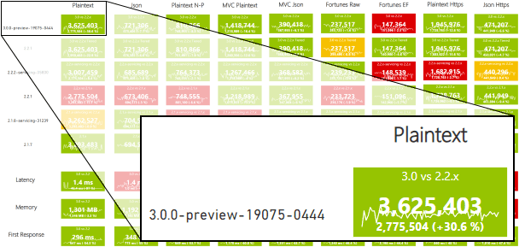
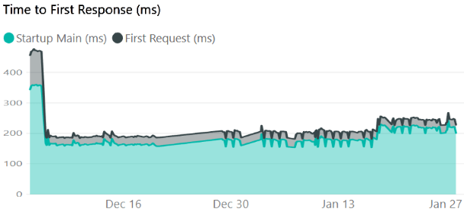

… and will be even faster
https://aka.ms/aspnet/benchmarks
6 minutes, 64 connections, 120.000.000 requests
Notes:
.NET is fast. Really fast! That means applications provide better response times and require less compute power. StackOverflow serves 5.3M page views a day on just 9 servers!
The popular TechEmpower benchmark compares web application frameworks with tasks like JSON serialization, database access, and server side template rendering - .NET performs faster than any other popular framework.
https://www.techempower.com/benchmarks/#section=data-r14&hw=ph&test=plaintext
The community has played a crucial role in performance work for the .NET stack.
https://blogs.msdn.microsoft.com/dotnet/tag/performance/

Slide 12


.NET is Open Source
Community Accepted PRs
“Samsung is embracing .NET because it is a completely open source project.” — Samsung
".NET is open source; that allows us to contribute back to it if we have any performance issues which Microsoft review and together we make a better product.“ — Illyriad Games
16,000+ Community Contributions from 3000+ Companies outside Microsoft
Notes:
We’ve seen companies taking a bet on .NET because it’s a completely open source project. More than 16,000 contributors* from 3300 companies have contributed to .NET Core and related open source repositories, with over half of the contributions coming from outside Microsoft.
Samsung is a big partner and are releasing their new Smart TVs that support .NET. They plan to expand to all their IoT devices too. Illyriad Games, specifically Ben Adams, contributed many performance enhancements to the platform. They build a MMO with hundreds of thousands of concurrent users so performance is super important to them. These enhancements not only benefit them but everyone that uses .NET.
*contributor = Submitted a Pull Request or Created an Issue

Slide 13

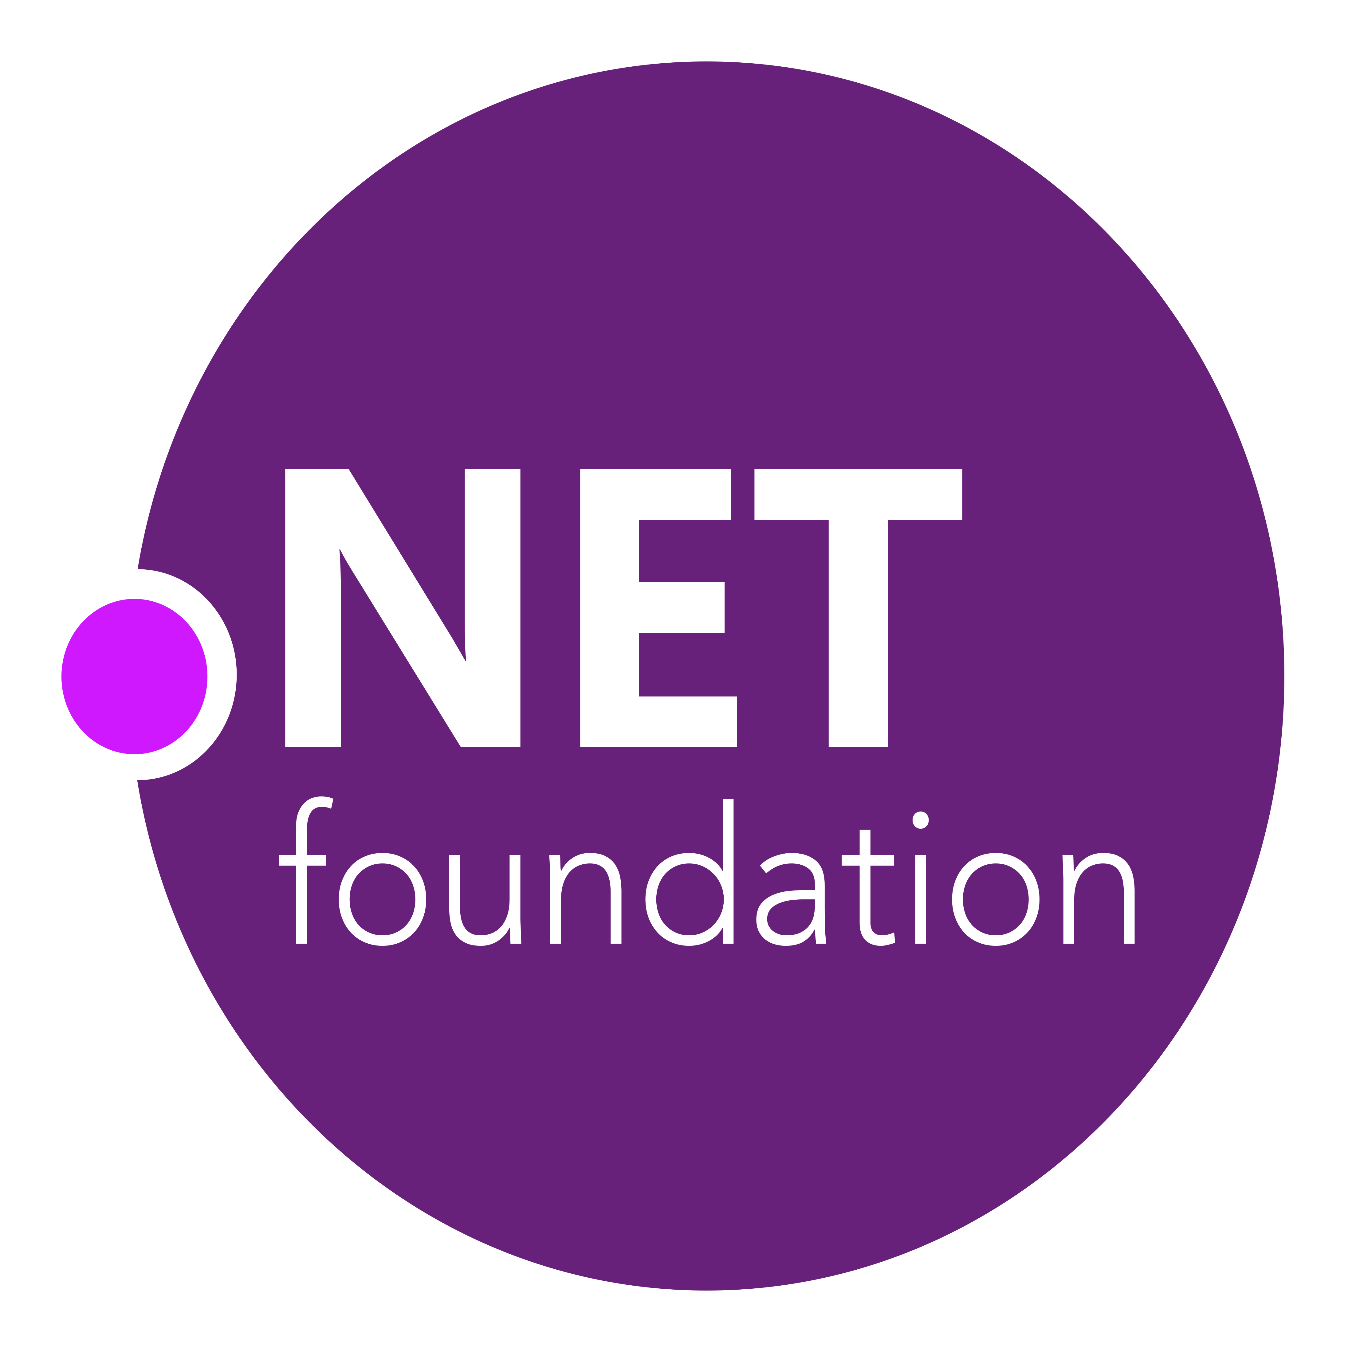
.NET Open Source Journey
2001- ECMA-335
2002- .NET 1.0 for Windows released, Mono project begins
April 2014- .NET Compiler Platform (“Roslyn”) Open Source .NET Foundation founded
Nov 2014- .NET Core Cross-plat, Open Source
2008- ASP.NET MVC (web platform) Open Source
.NET
Aug 2017- .NET Core 2
2016- Mono project joins .NET Foundation
Notes:
This didn’t happen overnight. Here’s a little history of .NET open source…..
Dec 2001-Feb 2002.
A new platform is born. Along with HP, Intel and others, the ECMA-335 standard was created that defined a common language infrastructure to support multiple programming languages. C# and Visual Basic.NET were released and F# came later in 2007, but there are over 20 other .NET languages today. Visual Studio .NET was released and included C#, VB, C++ development all in one box. This was the first IDE that was truly integrated across multiple languages.
Mono project begins. The CLI spec gave others the ability to create their own .NET implementations. Even though Microsoft built the first .NET Framework for Windows-only, the spec was intentionally portable across OSes and chipsets. The Mono project began, spearheaded by Miguel de Icaza, with the goal to implement Microsoft's new .NET development platform on Linux and Unix-like platforms. Later, Miguel started Xamarin which focused on cross-platform, native, mobile development with C#, built upon Mono. This allows developers to use C# and .NET to build apps for iOS and Android. Unity games development also emerged from Mono.
2008.
ASP.NET MVC web development stack is released to CodePlex as open source. This was the first application development framework from Microsoft to be released as open source. The underlying runtime and compilers were still closed however.
2014.
Hell freezes over & pigs fly. Early 2014 at Microsoft’s BUILD conference, Anders Hejlsberg, the father of C#, releases the .NET Compiler Platform “Roslyn” as open source on stage. Later in November, .NET Core project begins in the open. The technology world is shocked, and the .NET community is excited. .NET Core is a new cloud-native implementation of .NET that is geared for cross-platform, hyper-scale services as well as small IoT devices. It’s meant to bring .NET into the next 15 years of computing. And the community has been extremely supportive.
2016.
Mono comes home. In early 2016, Microsoft finally acquires Xamarin and brings Miguel de Icaza into Developer Division. Mono joins the .NET foundation and is officially supported and contributed to by Microsoft. The Microsoft community officially meets the Mono community.
2017.
.NET Core 2.0 Released. Our cross platform and open source implementation of .NET finally releases to the world with unified tooling support across multiple operating systems and editors.

Slide 14

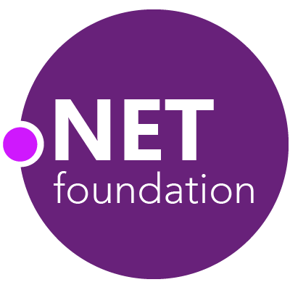
Steeltoe
.NET Core
Microsoft Web Protection Library
MSBuild
DotNetNuke
ASP.NET AJAX Control Toolkit
ASP.NET Core
SourceLink
Microsoft Azure WebJobs SDK
Salesforce Toolkits for .NET
nUnit
MVVM Light Toolkit
IronPython
Mailkit
WorldWide Telescope
Nancy
Open XML SDK
.NET SDK for Hadoop
MvvmCross
MEF
Mimekit
xUnit
ASP.NET Web Pages
NuGet
IdentityManager
Couchbase Lite for .NET
iOS
macOS
Entity Framework
.NET ECOSYSTEM
WCF
ILMerge
Xamarin.Mobile
ASP.NET SignalR
.NET Micro Framework
Open Live Writer
Mono
Xamarin.Auth
Xamarin SDK
Orchard CMS
OWIN Authentication Middleware
ProtoBuild
IdentityServer
Microsoft Azure SDK for .NET
.NET Compiler Platform ("Roslyn")
Prism
ASP.NET Web API
Cake
Orleans
Kudu
Cecil
LLILC
Umbraco
System.Drawing
ASP.NET MVC
Notes:
The .NET Foundation is our center of gravity for open development and collaboration around the .NET ecosystem. The .NET Foundation has over 60 projects and hundreds of repos under its stewardship. Open Source Software foundations provide protection, support, services and best practices for helping each project be successful and to grow the ecosystem of people and software.

Slide 15
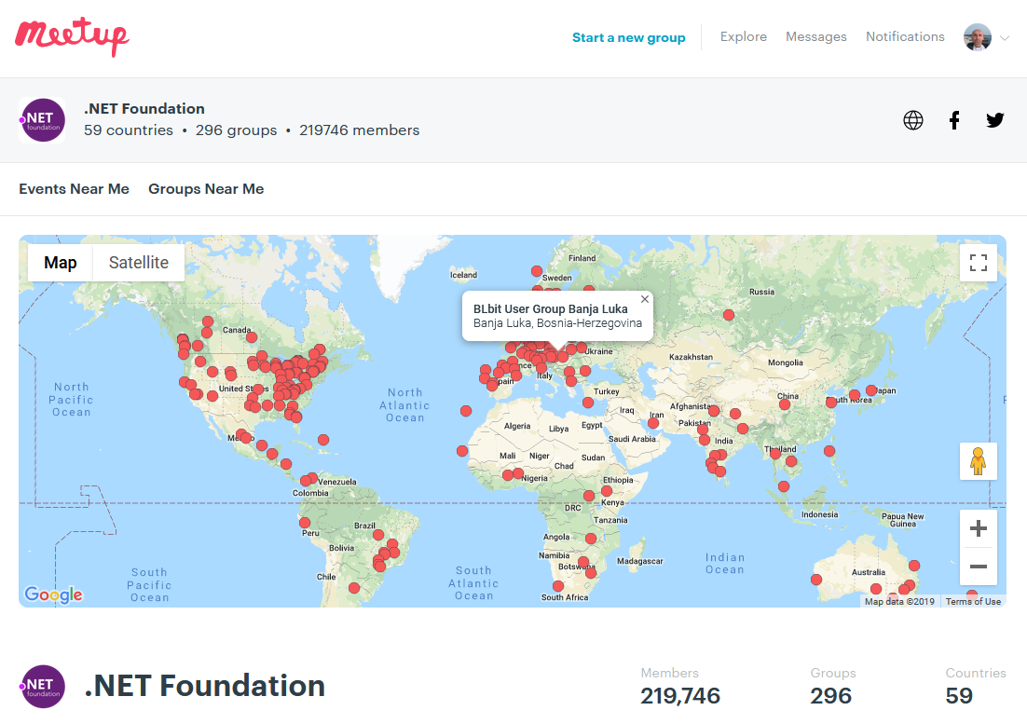
Meetups
These User Groups have presentations on all sorts of .NET topics
~300 groups and counting worldwide, just on meetup.com
A lot of UGs aren’t on meetup.com
Notes:
We’re a huge community and the .NET Foundation is key to help foster it. We have over 4 million developers worldwide and .NET has grown its developer base by 1 million over the last year. There are meetups all over the world that speak on all sorts of .NET topics and application development. Here are the ones on meetup.com.

Slide 16




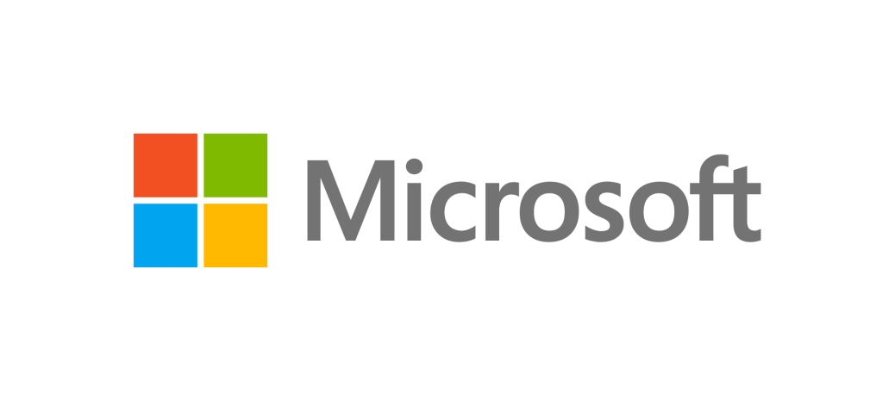

TECHNICAL STEERING GROUP MEMBERS
These companies are helping to drive the future of .NET
Notes:
And it’s not just individual developers, it’s large companies that are invested in the future of .NET. .NET is bigger than Microsoft. The technical steering group of the .NET Foundation is responsible for guiding .NET into the future together with industry partners.

Slide 17

BOARD OF DIRECTORS AND THE TEAM
Notes:
We were designed from the start as an independent forum to foster open development and collaboration across open source technologies for .NET. Our goal is to strengthen the .NET ecosystem through openness, rapid innovation, and community participation. If you get involved, we'll help you stay focused on producing high-quality software without the legal and administrative distractions and overhead. Keep your eye on the code and your users!

Slide 18

This is our mascot, dotnet-bot

Slide 19
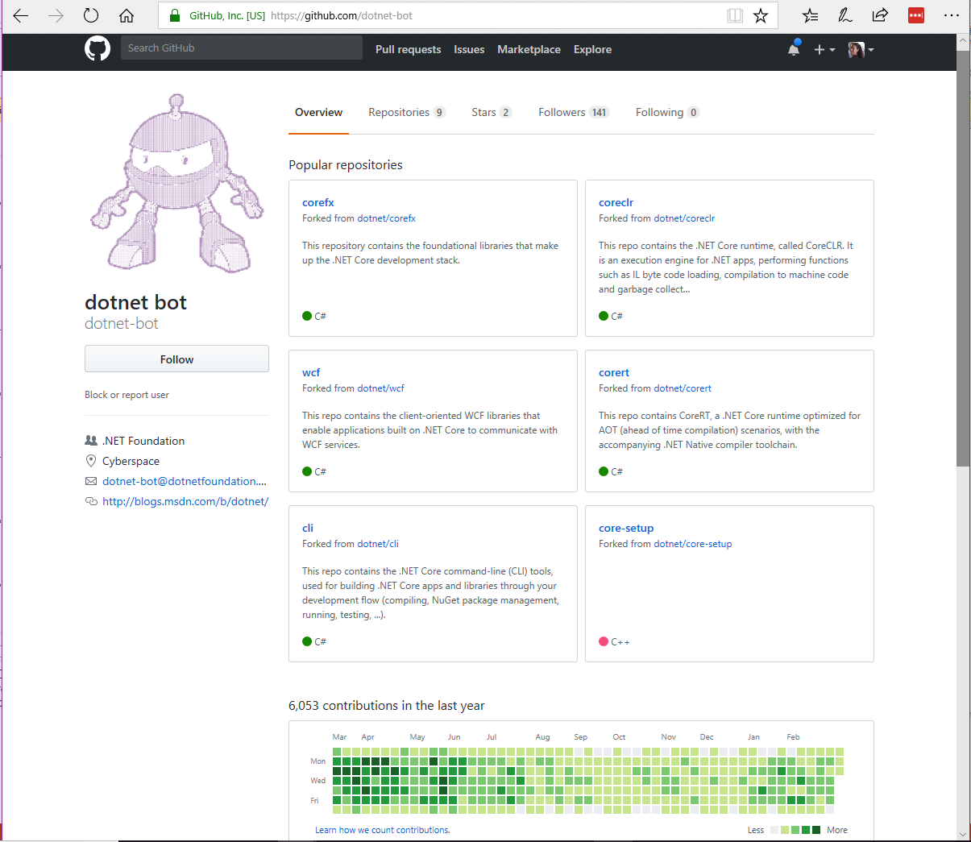
You can find dotnet-bot on GitHub
Notes:
Dotnet-bot helps us check the contributions (called Pull Requests) to make sure they are the developer’s original work. Dotnet-bot does this by checking if people have signed a contributor license agreement. This makes sure that the code that is submitted isn’t stolen from another product or company.

Slide 20
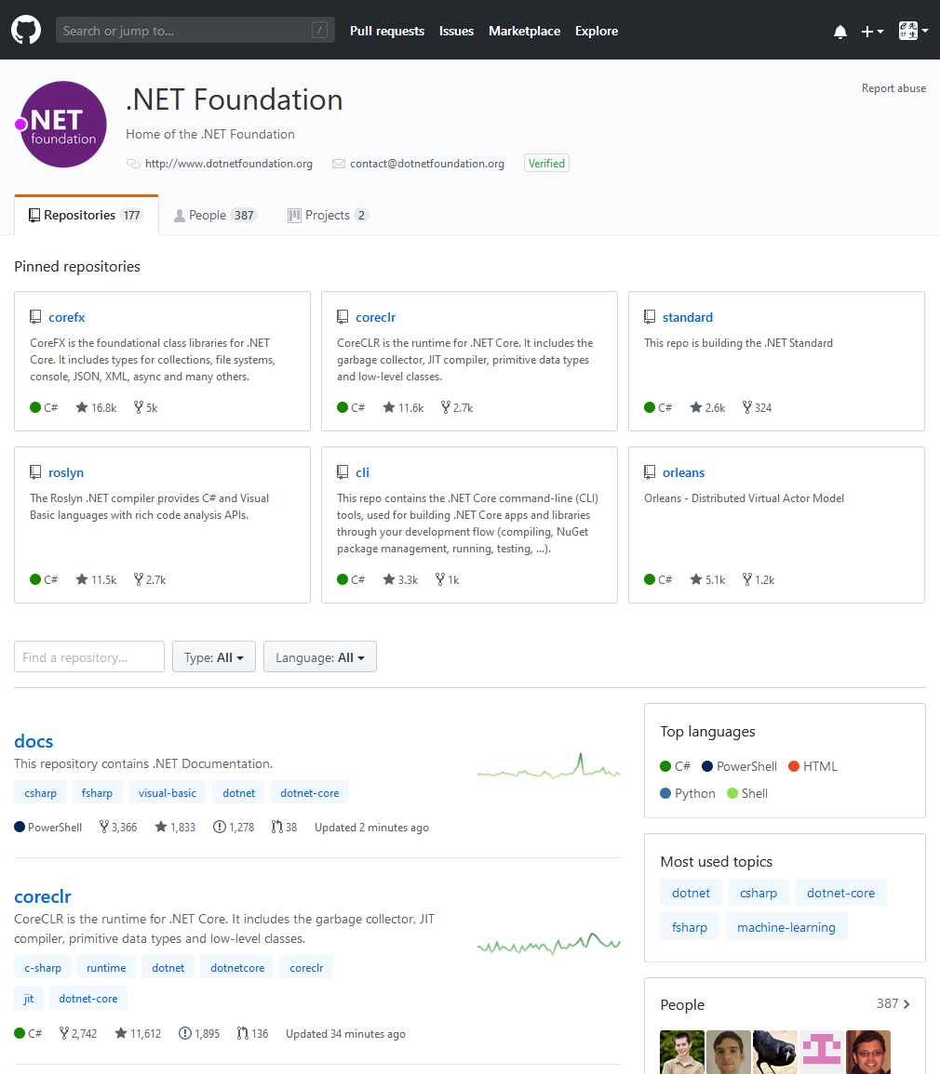
GitHub is where open source happens…
Notes:
I encourage you to look through GitHub – there are millions of open source projects there, some big, some small. To give you a sense of the size of .NET, take a look at how many PRs we’ve had, open discussions happening in issues, and stars (or likes) we’ve got.

Slide 21
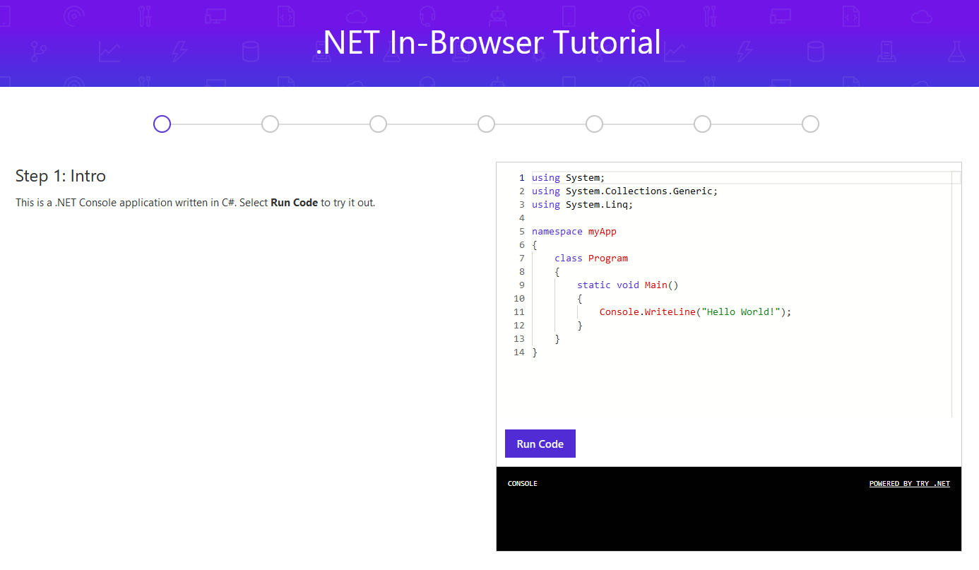
Learn how to program with C#
try.dot.net
Notes:
So you want to learn .NET? Start with a language. We make it easy to get started learning right in your browser.

Slide 22
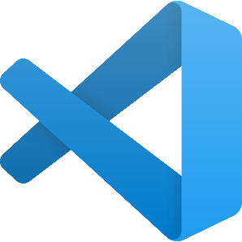

Make it easier with some free tools www.VisualStudio.com
Visual Studio
A fully-featured, integrated development environment (IDE) for developing .NET apps on a Windows PC development machine.
Visual Studio Code
Open source, cross-platform editor with .NET support.
Visual Studio for Mac
A fully-featured IDE for developing .NET apps on a Mac OS development machine.
Download from www.VisualStudio.com
Notes:
We also have free tools that can help you build your apps.

Slide 23
Future

Slide 24
The .NET Roadmap
Many
.NETs
2014
.NET FRAMEWORK
.NET CORE
XAMARIN / MONO
Runtime
Runtime
Runtime
Base class library
Core library
Mono class library

Slide 25
The .NET Roadmap
Many
.NETs
.NET
standard
2014
2016
.NET FRAMEWORK
.NET CORE
XAMARIN / MONO
Runtime
Runtime
Runtime
Base class library
Core library
Mono class library
.NET STANDARD

Slide 26
The .NET Roadmap
Many
.NETs
.NET
standard
.NET
2014
2016
Next
.NET FRAMEWORK
.NET CORE
.NET
XAMARIN / MONO
Runtime
Runtime
Runtime (JIT & native)
Runtime
Core library
Base class library
One base class library
Mono class library
.NET STANDARD

Slide 27
.NET 5
Supports all .NET application types
Evolution of .NET Core, adding the best of Mono into one unified platform
One BCL implementation, still adheres to .NET Standard
One toolchain (SDK style projects)
Both Just-in-Time (JIT) and native models supported
Interop with Java and Swift

Slide 28
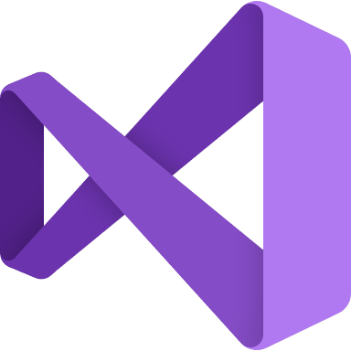


.NET - a unified platform
TOOLS
DESKTOP
WEB
CLOUD
MOBILE
GAMING
IoT
AI
WPF
Windows forms
UWP
ASP.NET
Azure
Xamarin
Unity
ARM32
ARM64
ML.NET
.NET for Apache Spark
VISUAL STUDIO
.NET STANDARD
VISUAL STUDIO FOR MAC
.NET 5
VISUAL STUDIO CODE
INFRASTRUCTURE
RUNTIME COMPONENTS
COMPILERS
LANGUAGES
COMMAND LINE INTERFACE

Slide 29
.NET Schedule
July 2019
.NET Core 3.0
RC
Sept 2019
.NET Core 3.0
Nov 2019
.NET Core 3.1
LTS
Nov 2020
.NET 5.0
Nov 2021
.NET 6.0
LTS
Nov 2022
.NET 7.0
Nov 2023
.NET 8.0
LTS
.NET Core 3.0 release in September
.NET Core 3.1 = Long term support (LTS)
.NET 5.0 release in November 2020
Major releases every year, LTS for even numbered releases
Predictable schedule, minor releases if needed

Slide 30
Thanks! Questions?
@miroslavpopovic
https://miroslavpopovic.com

